Slide 1
Content Objective: Students will use post-it notes and create a gallery walk of information for 6 foundational ethical terms.
Monday Nov. 11
Abandon Ship Recap
Your Ethical Code
Gray Area Project
Homework
During projects only...

Slide 2
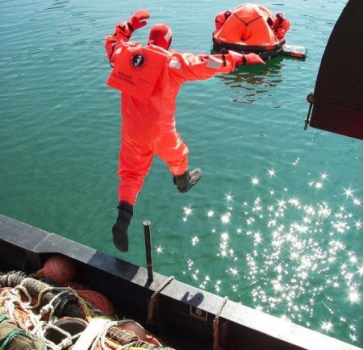
Abandon Ship Activity
“Ethics of Us”
Recap - How did this go? What values were prioritized?
Did we think as a deontologist, consequentialist, or under virtue ethics?

Slide 3
Ethical Code Activity
“Ethics of You”
Ethical Data Gathering
Let’s gather data on the classrooms ethical beliefs.
Do you think like an absolutist, relativist, or objectivist?
Evil
Neutral
Good

Slide 4
Deontology Consequentialism Virtue Ethics
Use post-it notes / gallery walk style.
Large Group Cardboard Posters to be Hung in Class

Slide 5

Ethics of “You” vs. the Ethics of “Us”
As a member of the LGBTQ community, you and your husband decided you wanted to get married. You saw nothing wrong with loving another person of the same gender. However, this is America before 2015, and gay marriage is illegal in your state. You decide to drive to a state that legalized it in an act of rebellion.
The ethics of “you” is what? What do you believe in?
The ethics of “us” is what? What does America believe?

Slide 6
In order to build a moral compass we need to understand some basic ethical theories...
How do you personally act in certain situations? What do you believe in?
Absolutism?
Relativism?
Objectivism?
How does everyone decide on how to act? What does humanity believe in?
Deontology?
Consequentialism?
Virtue Ethics?

Slide 7

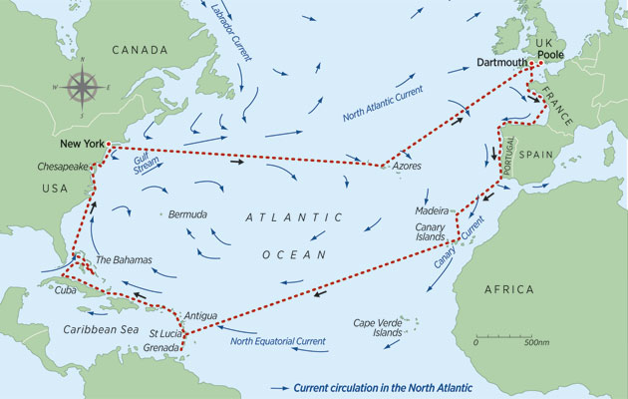

The Sea Captain Problem
The year is 1600 and you’re on a boat that is trying to sail across the ocean. What tool can you use to help you cross? What if you did not have that tool? What might happen to your boat?

Slide 8

Moral Compass - Do You Have One?
What does a Compass do?
Do you need a Moral Compass to survive in life?

Slide 9
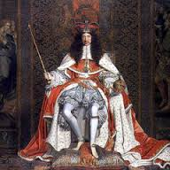
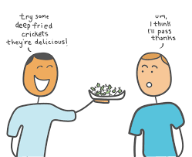

Absolutism Relativism Objectivism
This guy rules the land and says that slavery is bad and humans should be free. Should we give him more power if he has good morals?
Is this glass half full or half empty?
Is there a truth separate from human thought that just is?
Where does this truth come from?
You like eating deep fried crickets. I don’t. Who cares, it’s all relative!

Slide 10
Absolutism Relativism Objectivism
Use post-it notes / gallery walk style.
Large Group Cardboard Posters to be Hung in Class

Slide 11


AI is a tool just like the compass...if the compass was broken or built wrong what might happen?
Ending Note

Slide 12



AI & Ethics - You Teach Me...
What do we already know about AI & Ethics? Let’s define AI / Ethics...

Slide 13


My Results
What am I missing...
Who would I be best matched with?
What about you? Find 1-2 people to complete a group!

